Slide 1
C.3 Ransomware – Apr 15
Agenda
Case Study C.3 Ransomware
Complete & Upload for Monday
Mod B.3 Intermediate Python
Demo your Tic-Tac-Toe Program
Upload Your Answers
Upcoming
t.b.d.

Slide 2
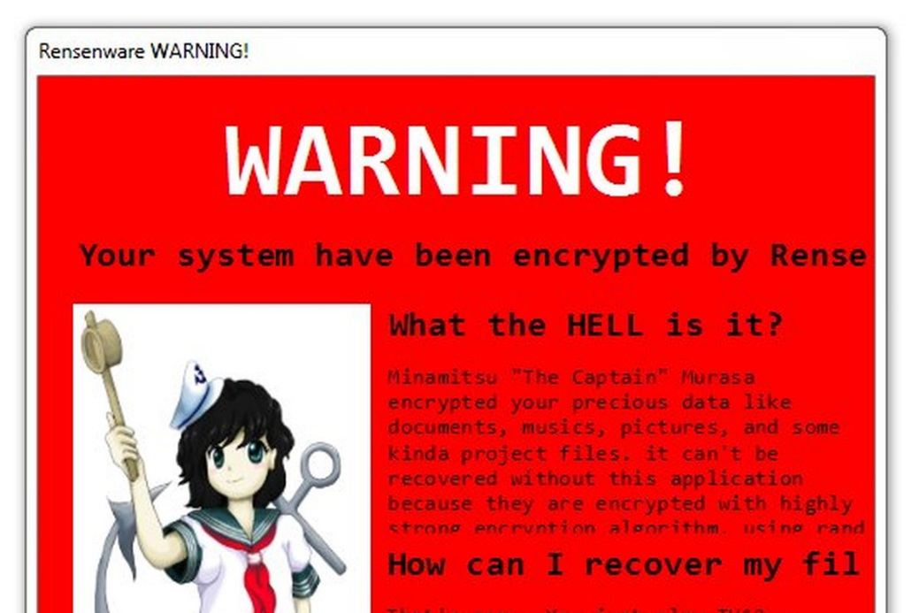

Ransomware
Key
“ffsdfdsg” ➔ “message”
Encryption
“message” ➔ “ffsdfdsg”

